Slide 1
PACFA on the Road Sample Presentation
Four Big Trends, Two Big Concepts, Lessons Learned
and
How you can help
Michael L. Batchelor
President
Mike@pacfapartners.org
814-882-2521

Slide 2
My background…
32 years as CEO of The Erie Community Foundation
Transformed a quiet and reactive community foundation into a community leadership organization.
Raised $300 million, asset growth from $20 million to $350 million, oversee distribution of @ $400 million.
Created Erie Gives, Nonprofit Partnership, Regional Affiliates, Erie Women’s Fund, Erie Vital Signs, Susan Hirt Hagen Center for Transformational Philanthropy.
Helped establish PA’s first new community college over 25 years, a $27 million downtown investment fund and used corpus to attract over $50 million in Opportunity Zone Investments.
Expanded Magee Women’s Research Institute from Pittsburgh to Erie.
Created $3 million fund focused on Diversity, Equity and Inclusion.
Helping Today… Shaping Tomorrow… Transformational Philanthropy

Slide 3
The Basics

Slide 4
What is a Community Foundation?
A community foundation is a tax-exempt, nonprofit, autonomous, nonsectarian philanthropic institution supported by the public with the long-term goals of:
Building permanent, component funds established by many separate donors to carry out their charitable interests
Supporting the broad-based charitable interests and benefitting the residents of a defined geographic area, typically no larger than a state
Serving in leadership roles on important community issues

Slide 5
But we are all different...
Take Pride in Neutrality vs. Vocal Community Leadership
Independence vs. Partnership
Reactive vs. Proactive
Run Programs vs. Fund Programs
Love Giving Days vs. Hate Giving Days
Encourage Scholarships vs. Discourage Scholarships
Donor Advisor “education” vs. Donor Advised “service”
Permanent vs. Pass-Through
Unrestricted Income focus
Use of Income vs. Use of Assets
Discussion: Where is your community foundation now?
Where are you heading?

Slide 6
Typical Mission Statement Evolution
Focus on asset growth and donor service
“Helping donors accomplish personal philanthropic and estate planning objectives in a cost-effective fashion.”
Focus on community problem solving
“Identifying and addressing the most crucial needs of our region.”
Focus on inclusivity
“Building an equitable region where all can thrive.”

Slide 7
What is PACFA?
Membership Association: Representing 34 different community foundations in Pennsylvania with asset over $4 billion
Mission: Serve members by providing high quality, value-add, educational and capacity building programs. Help our community foundation members connect, learn and where appropriate, act collectively.
Thank you for your membership

Slide 8
Four Big Trends….

Slide 9
#1 Rapid Growth
833 US community foundations assets grew 13% in 2021 to $143.9 billion
In last five years, US community foundation assets have grown 58%, while distributing billions to local nonprofits
There are 150 US community foundations with assets of $100 million or more
Growing international network
Discussion: Are you keeping pace?

Slide 10
#2 Increased Scrutiny
Loss of faith in all institutions
Charitable Scandals
DAF Perceived Abuses
Government Seeking Increased Tax Revenue
Discussion: Are you feeling this?

Slide 11
#3 Increasing Community Leadership Role for CF’s
Changing local landscape
Increased assets = Increased leadership opportunity?
Grantmaking will not fix societal problems
Lead by neutral convening and/or by topical advocacy
Discussion: Are you a community leader? ECF, “we are at risk if we lead, and we are at risk if we don’t lead”

Slide 12
#4 Desire to be “Transformational”
Tired of Band-Aids
Desire to fix something
Using All Assets – Influence and Impact Investing
Increased focus on advocacy and public policy
ECF Example - Helping Today, Shaping Tomorrow, Transformational Philanthropy
Discussion: Is this your future? Can you “dip your toes” into this?

Slide 13
What are you thinking?

Slide 14
Four Basic Questions

Slide 15
What business are you in?

Slide 16
Who are your customers?

Slide 17
Who are your competitors?

Slide 18
What are your competitive advantages?

Slide 19
Two Big Concepts

Slide 20
Two Big Concepts
#1 Manage the “Legs of the Stool”
Money In, Money Out, Money Management, Donor Stewardship, Donor Education, Community Leadership, Nonprofit Capacity Building, Knowledge Management, Etc.
Discussion: What is your current focus? What will it be?

Slide 21
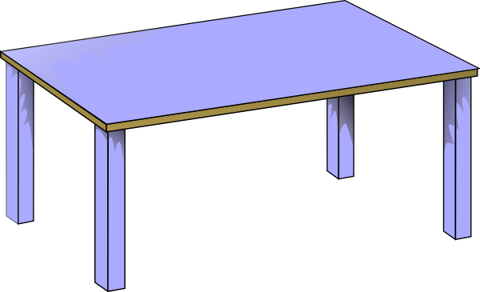
Two Big Concepts
#2 Get to the donor side of the table
“Know you, Like you, Trust you” continuum
Gift of Income vs. Gift of Asset
Discussion: Where are you now? You know you’ve got it made when…

Slide 22
How you can help…
Establish strategic direction
Create an environment of respect, trust and candor
Empower and support CEO
Understand your business model
Embrace vigorous debate
Share the elevator speech
Ask the charitable question… “Have you considered….”
Give, Lead by example
Make referrals
Have a plan, but be opportunistic
Evaluate your board meetings

Slide 23
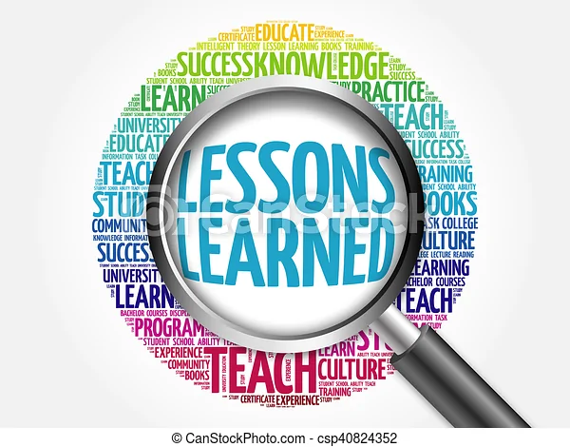
So, after 32 years….
Discussion: Where are you heading? What is next?

Slide 24
Some Lessons Learned….
Community Leadership will help, and hurt, asset development
Once you jump off Community Leadership cliff, you can’t go back
You are at risk if you lead, and you are at risk if you don’t lead
The importance of determining “how good is good”
Convening, Collaborating and Leading. Know where you are
Do they want “two cents worth”, or “two cents”
Don’t take yourself too seriously. Don’t always believe your press
The need for basic grantmaking never goes away
Need to have the best board in town
Balance “inclusion” and “mystique”

Slide 25
What is your future??

